Slide 1


Learning Successor Representations
(i) A generalized HPC model for learning SR and
(ii) Hebbian plasticity as an approximation to learning SR
Funky image
Tom George
Will de Cothi, Kim Stachenfeld & Caswell Barry

Slide 2

Successor theory
•
not
Cheap dot-product
over states.
If R(s) changes, all is not lost!
•
Discounted sum of future occupancies
TD learnable
•
1

Slide 3
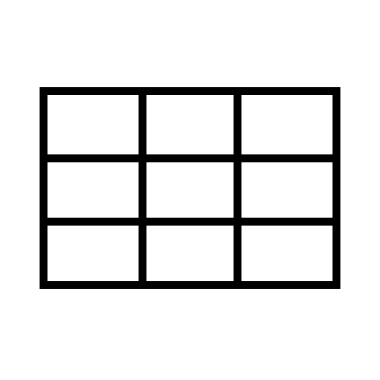

Successor theory and why hippocampus
HOME
THAT ANNOYING
POT HOLE R=-5
•
•
STARBUCKS
R=+10
BARRY LAB
PUB NIGHT
R=+100
•
1

Slide 4
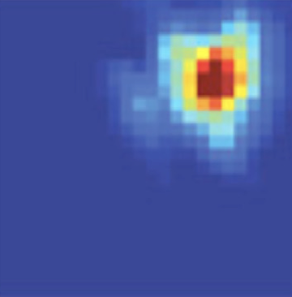
Successor theory and why hippocampus
•
•
•
1

Slide 5
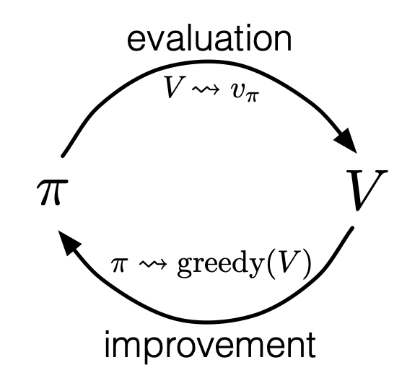
Successor theory and why hippocampus
•
Fixed policy:
Policies often are fixed
Value learning still useful
Policy iteration:
•
•
1

Slide 6
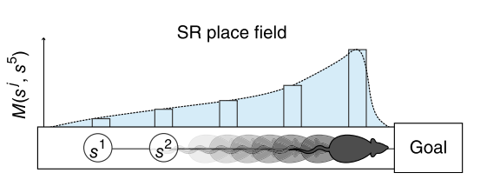
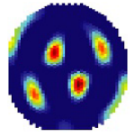
Successor theory and why hippocampus
PLACE CELLS:
= “how well does state s predict future occurrence of state s’ “
•
•
GRID CELLS:
Encodes how locations connectivity.
M eigenvectors encode a spatial metric…aka grid cells
•
1

Slide 7
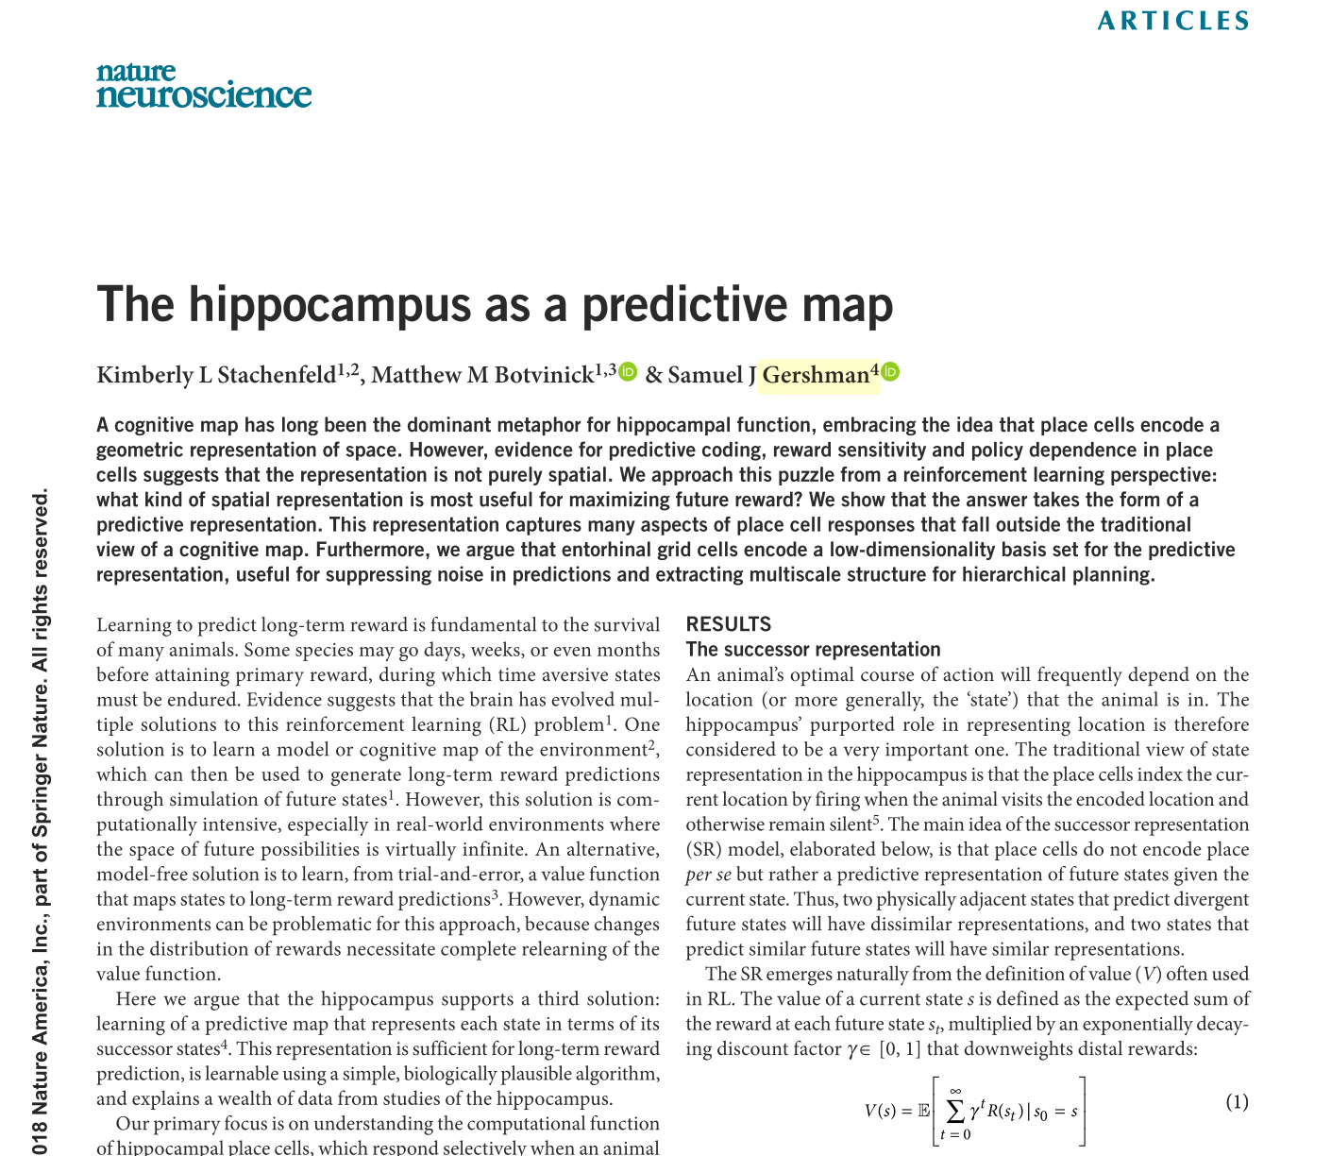
Successor theory and why hippocampus
PLACE CELLS:
= “how well does state s predict future occurrence of state s’ “
•
•
GRID CELLS:
Encodes how locations connectivity.
M eigenvectors encode a spatial metric…aka grid cells
•
1

Slide 8
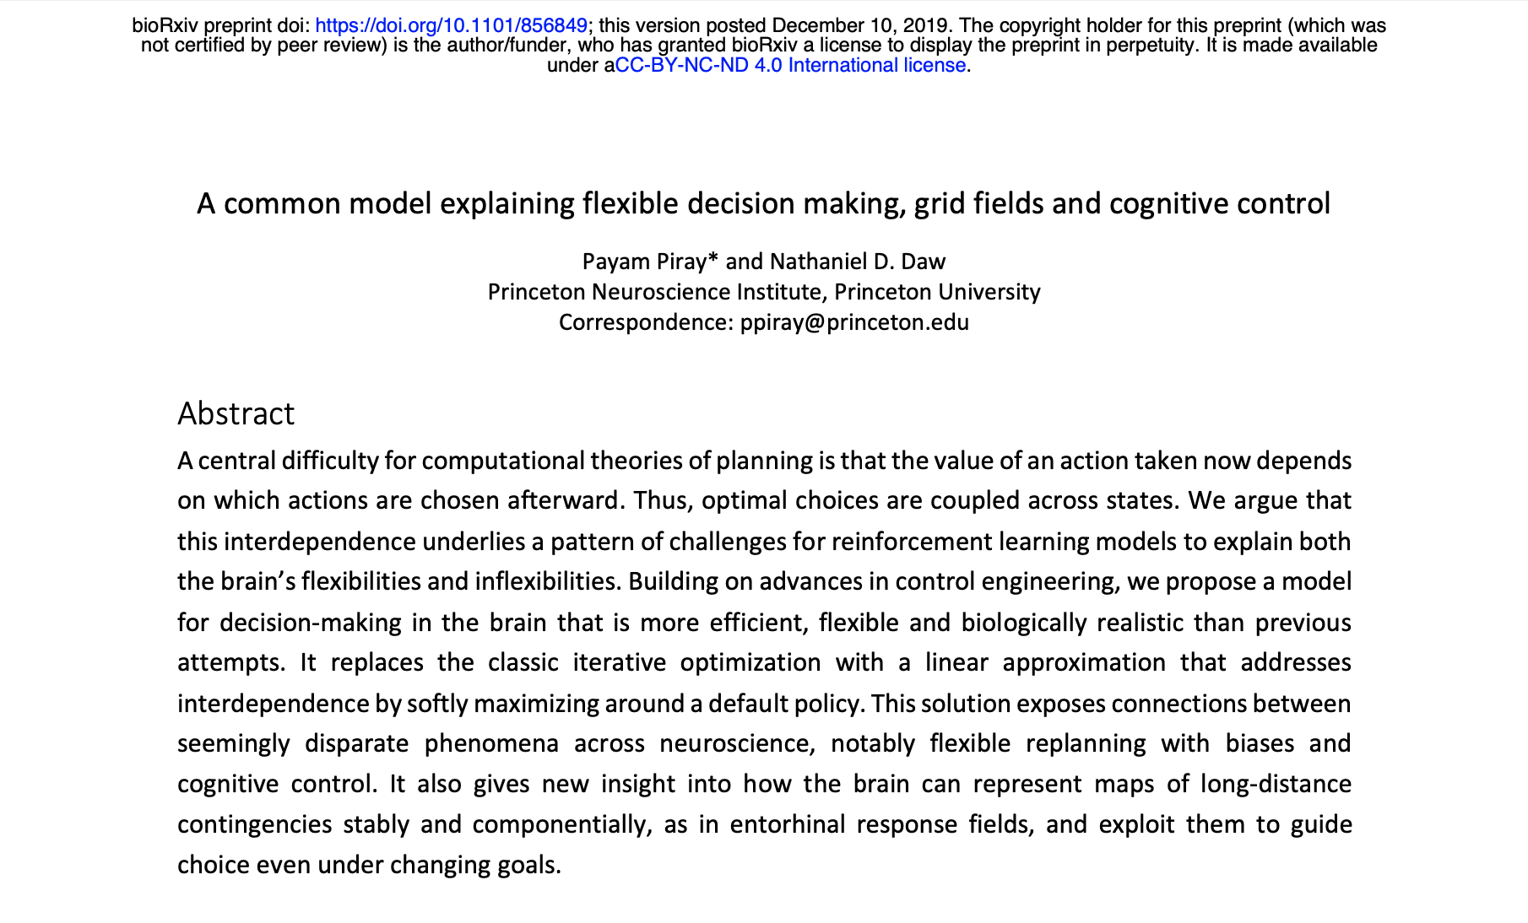
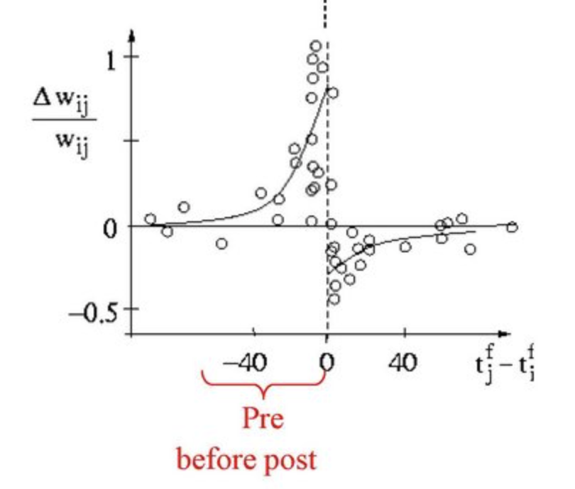
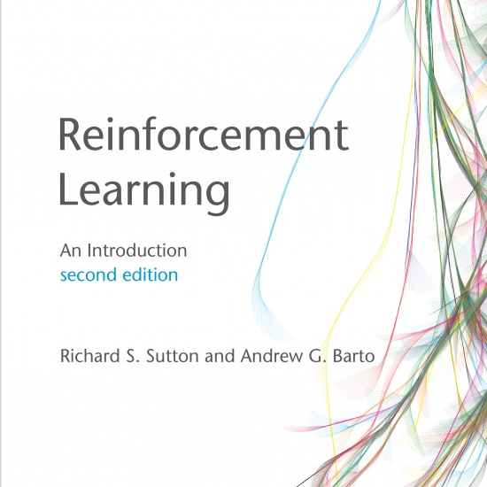
Successor theory and why hippocampus
(1)
Insert favourite RL rule
here…
(2)
We don’t learn it!
(3)
Hebbian STDP
We actually have to
learn this, somehow?
•
1

Slide 9
Roadmap
A state-general, space-and-time-continuous TD learning rule for SR
STDP as an approach to learning SR

Slide 10
Roadmap
A state-general, space-and-time-continuous TD learning rule for SR
STDP as an approach to learning SR

Slide 11
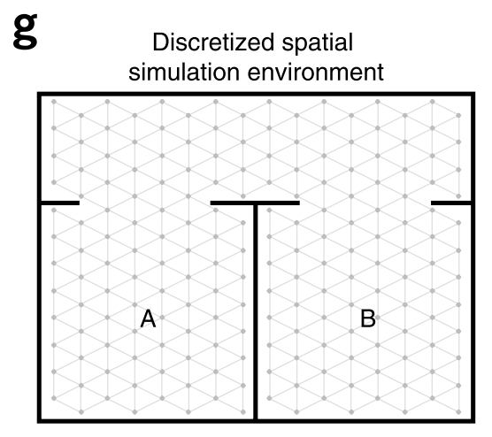

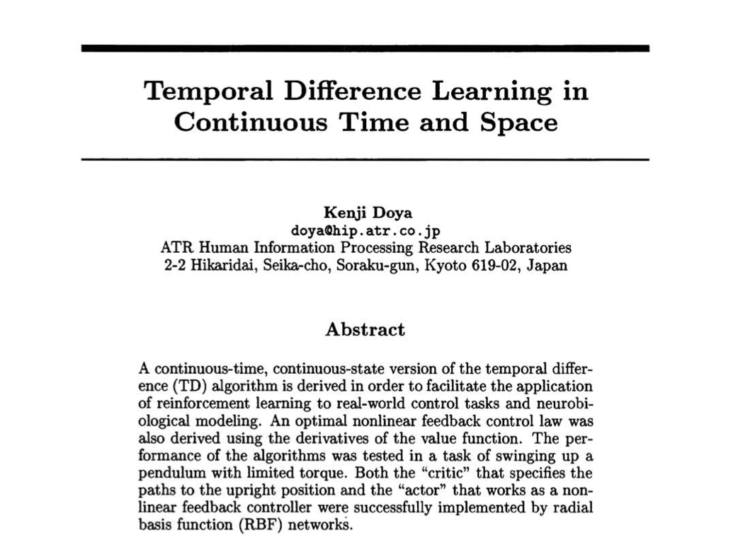
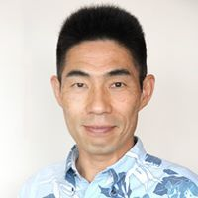
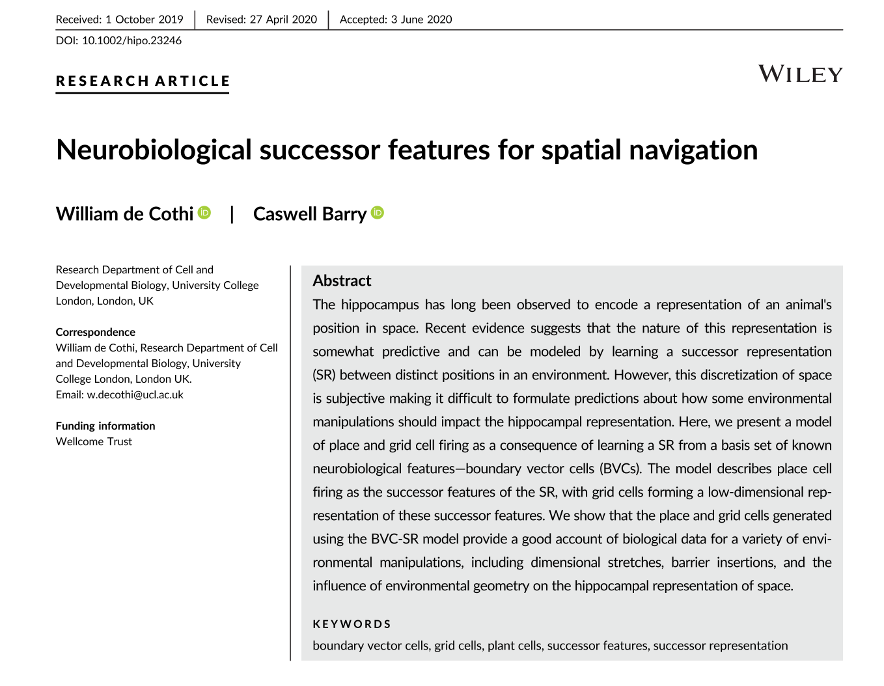

Three problems with SR models
(1)
Discrete in space
Trivial solution
(2)
Discrete in time
(3)
One-hot’s only

Slide 12
Flexible and plausible state representations
Non-one-hot analogue
Represented as linear combination of basis cells
Notational change: state s → population vector f
TASK: Learn M to improve ψ
• Least squares loss minimization
• Bootstrap TD update
stepSize
newEstimate
oldEstimate
stateToUpdate
TD error

Slide 13
Continuous time
Gamma is NOT independent of simulation time step, dt
Discrete time steps:
γ
f(x₀)
x₀
x₁
x₂
• • •
1

Slide 14
Continuous time
Continuous time:
exp (- dt / τ) = (1 - dt / τ)
f(x(t)) / τ
dt

Slide 15
Continuous time
Continuous time:
Examples where such flexibility might be useful:
Replay
Near rewards / decision points
Vary τ, e.g. longer in less interesting / more predictable environments
exp (- dt / τ) = (1 - dt / τ)
f(x(t)) / τ
dt

Slide 16
Final form of TD learning rule:
Continuous space
Continuous time
Generalised state representations

Slide 17
Definition of place fields:
Basic cells, f
M
eigenvectors of M
Place cells, PC
Grid cells, GC

Slide 18
Results
Multi maze, multi policy
Model works (grid cells, place cells)
Behavioural bias leads to skewed grid cells
Trivial implementation of rapid replay learning

Slide 19
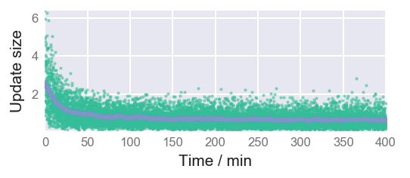
Single room exploration
Basis cells
30 secs
(but full exploration lasts ~2 hours)
Receptive field of
basis cell₁₁₇
Place cell₁₁₇
after exploration

Slide 20
Single room exploration – One hot

Slide 21
Grid cells of various length scales

Slide 22
Multiroom room exploration
Mixture of globally coherent and locally coherent grid cells

Slide 23
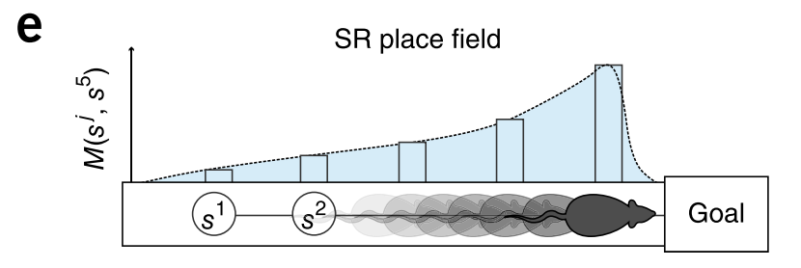



Behaviourally biased place cells: Loop maze
τ = 8s, v = 0.16m/s ==> PC size ~= 1.3m

Slide 24
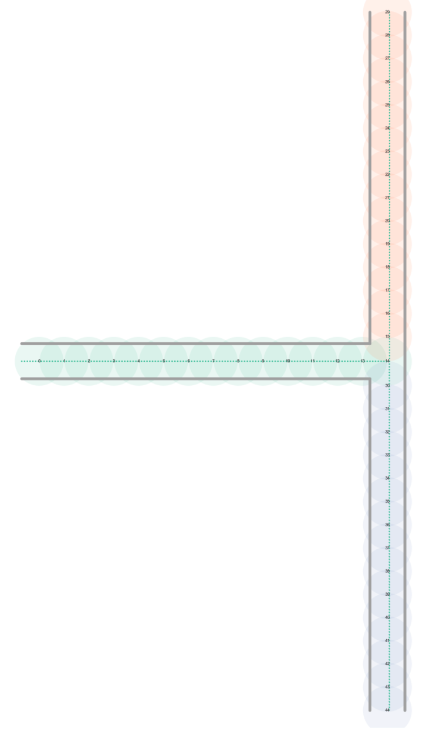
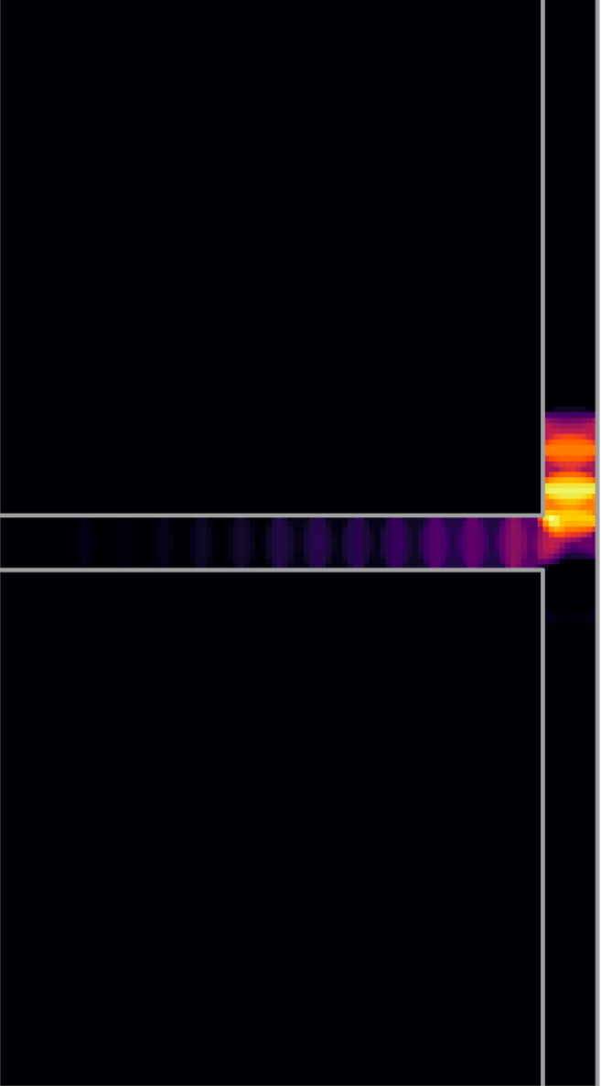
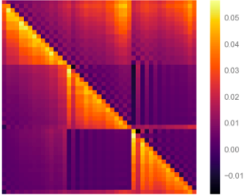
Behaviourally biased place cells: T-Maze
A place cell
Feature cells
Successor matrix
66%
34%

Slide 25
Conclusions:
Flexible model of SR learning (probably over detailed)
Capable of reproducing “classic” place/grid cell results + more
Olfactory Cortex
IT Cortex
Future directions:
Replay
Mixture of spatial and sensory input features
Non-linear model of successor features
Sensory inputs
Non-linear(?)
Sensory drive
Sensory drive
Vector navigation
Place
Grids
PCA

Slide 26
Roadmap
A state-general, space-and-time-continuous TD learning rule for SR
STDP as an approach to learning SR

Slide 27
Issues with learning via TD
Physically how is this done
Is it necessary, aren’t most policies fairly simple
This isn’t a fundamentally hard thing
Nor need it be particularly precise/accurate to be useful

Slide 28
STDP: “cells that fire together, wire together”
Time scale issue

Slide 29
Theta sweeps could provide increase time scale to STDP range and increase training data

Slide 30
Implementation

Slide 31
STDP learning rule

Slide 32
Results

